Slide 1

Regular Expressions
Chapter 6

Slide 2
Regular Languages
Regular Language
L
Regular Expression
Accepts
Finite State Machine

Slide 3
Regular Expressions
The regular expressions over an alphabet Σ are all and only the strings that can be obtained as follows:
1. ∅ is a regular expression.
2. ε is a regular expression.
3. Every element a ∈ Σ is a regular expression.
4. If α , β are regular expressions, then so is αβ.
5. If α , β are regular expressions, then so is α∪β.
6. If α is a regular expression, then so is α*.
7. α is a regular expression, then so is α⁺.
8. If α is a regular expression, then so is (α).

Slide 4
Regular Expression Examples
If Σ = {a, b}, the following are regular expressions:
∅
ε
a
(a ∪ b)*
abba ∪ ε

Slide 5
Regular Expressions Define Languages
Semantic interpretation: the language L(α) expressed by a regular expression α:
1. L(∅) = ∅.
2. L(ε) = {ε}.
3. L(c) = {c}, where c ∈ Σ.
4. L(αβ) = L(α) L(β).
5. L(α ∪ β) = L(α) ∪ L(β).
6. L(α*) = (L(α))*.
7. L(α⁺) = L(αα*) = L(α) (L(α))*. If L(α) is equal to ∅, then L(α⁺) is also equal to ∅. Otherwise L(α⁺) is the language that is formed by concatenating together one or more strings drawn from L(α).
8. L((α)) = L(α).

Slide 6
Example
L((a ∪ b)*b) = L((a ∪ b)*) L(b)
= (L((a ∪ b)))* L(b)
= (L(a) ∪ L(b))* L(b)
= ({a} ∪ {b})* {b}
= {a, b}* {b}.

Slide 7
Examples
L( a*b* ) =
L( (a ∪ b)* ) =
L( (a ∪ b)*a*b* ) =
L( (a ∪ b)*abba(a ∪ b)* ) =

Slide 8
Going the Other Way
L = {w ∈ {a, b}*: |w| is even}

Slide 9
Going the Other Way
L = {w ∈ {a, b}*: |w| is even}
((a ∪ b) (a ∪ b))*
(aa ∪ ab ∪ ba ∪ bb)*

Slide 10
Going the Other Way
L = {w ∈ {a, b}*: |w| is even}
((a ∪ b) (a ∪ b))*
(aa ∪ ab ∪ ba ∪ bb)*
L = {w ∈ {a, b}*: w contains an odd number of a’s}

Slide 11
Going the Other Way
L = {w ∈ {a, b}*: |w| is even}
((a ∪ b) (a ∪ b))*
(aa ∪ ab ∪ ba ∪ bb)*
L = {w ∈ {a, b}*: w contains an odd number of a’s}
b* (ab*ab*)* a b*
b* a b* (ab*ab*)*

Slide 12
More Regular Expression Examples
L ( (aa*) ∪ ε ) =
L ( (a ∪ ε)* ) =
L = {w ∈ {a, b}*: there is no more than one b in w}
L = {w ∈ {a, b}* : no two consecutive letters in w are the
same}

Slide 13
Operator Precedence in Regular Expressions
Regular Arithmetic
Expressions Expressions
Highest Kleene star exponentiation
concatenation multiplication
Lowest union addition
a b* ∪ c d* x y² + i j²

Slide 14
The Details Matter
a* ∪ b* ≠ (a ∪ b)*
(ab)* ≠ a*b*

Slide 15
The Details Matter
L₁ = {w ∈ {a, b}* : every a is immediately followed a b}
A regular expression for L₁:
A FSM for L₁:
L₂ = {w ∈ {a, b}* : every a has a matching b somewhere}
A regular expression for L₂:
A FSM for L₂:

Slide 16
Kleene’s Theorem
Finite state machines and regular expressions define the same class of languages.
Theorem 6.3 (Kleene): The class of languages that can be defined with regular expressions is exactly the class of regular languages.

Slide 17
For Every Regular Expression
There is a Corresponding FSM
Proof: By construction (Thompson’s construction: simpler than the one in textbook).
We shall build a NDFSM for each regular expression such that:
- its starting state has no incoming edges
- it has only one accepting state that has no outgoing edges
We use structural induction:

Slide 18
For Every Regular Expression
There is a Corresponding FSM
NDFSM’s for the basic blocks:
∅:
A single element a ∈ Σ:
a

Slide 19
Concatenation
α = β γ: build a NDFSM for L(α)
L(β)
ε
L(γ)

Slide 20
Union
α = β ∪ γ: build a NDFSM for L(α)
L(β)
ε
ε
ε
ε
L(γ)

Slide 21
Kleene *
α = β*: build a NDFSM for L(α)
ε
ε
L(β)
ε
ε

Slide 22
Example
α = (aa ∪ b)*
ε
a
ε
a
ε
ε
ε
ε
ε
b
ε
ε

Slide 23
For Every FSM There is a Corresponding Regular Expression
We’ll show this by construction.
The key idea is that we’ll allow arbitrary regular expressions to label the transitions of an FSM.

Slide 24
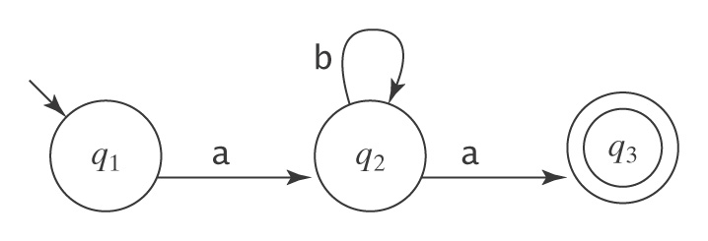
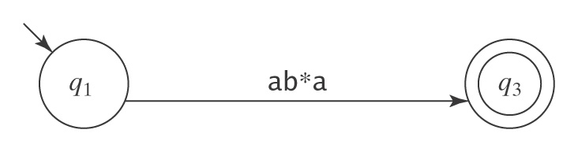
A Simple Example
Let M be:
Suppose we rip out state 2:

Slide 25
The Algorithm fsmtoregexheuristic
fsmtoregexheuristic(M: FSM) =
1. Remove unreachable states from M.
2. If M has no accepting states then return ∅.
3. If the start state of M is part of a loop, create a new start state s
and connect s to M’s start state via an ε-transition.
4. If there is more than one accepting state of M or there are any
transitions out of any of them, create a new accepting state and
connect each of M’s accepting states to it via an ε-transition. The old accepting states no longer accept.
5. If M has only one state then return ε.
6. Until only the start state and the accepting state remain do:
  6.1 Select rip (not s or an accepting state).
  6.2 Remove rip from M.
  6.3 *Modify the transitions among the remaining states so M
  accepts the same strings.
7. Return the regular expression that labels the one remaining
transition from the start state to the accepting state.

Slide 26
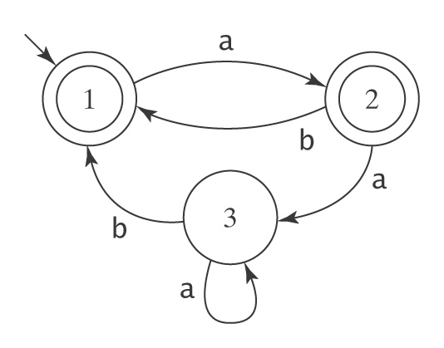
An Example
1. Create a new initial state and a new, unique accepting state, neither of which is part of a loop.

Slide 27
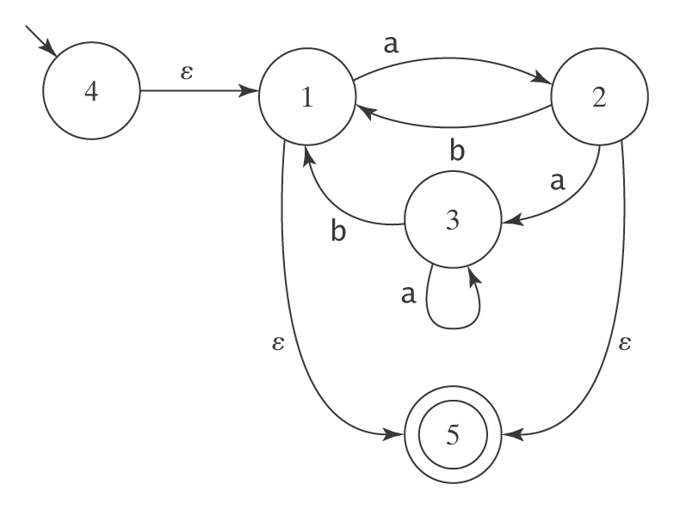
An Example, Continued
2. Remove states and arcs and replace with arcs labelled
with larger and larger regular expressions.

Slide 28
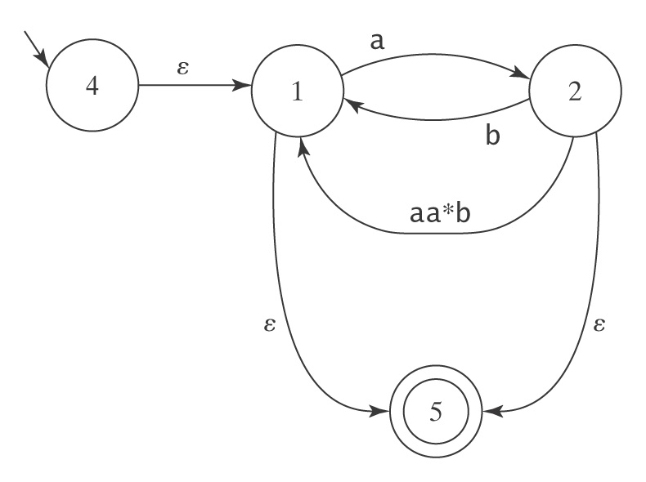
An Example, Continued
Remove state 3:

Slide 29
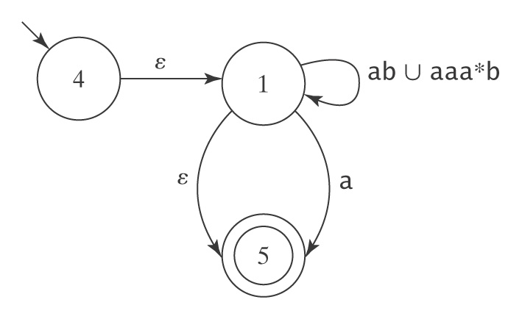
An Example, Continued
Remove state 2:

Slide 30
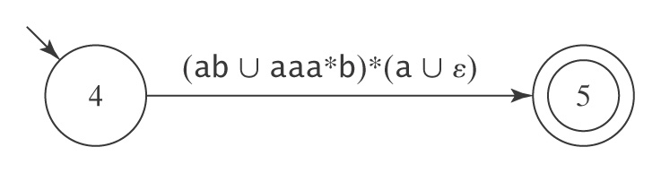
An Example, Continued
Remove state 1:

Slide 31
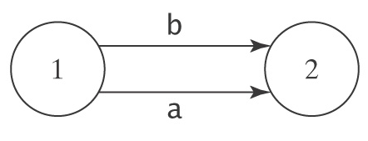
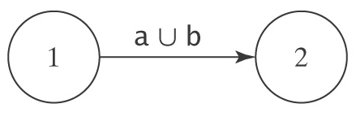
Further Modifications to M Before We Start
We require that, from every state other than the accepting state there must be exactly one transition to every state (including itself) except the start state. And into every state other than the start state there must be exactly one transition from every state (including itself) except the accepting state.
1. If there is more than one transition between states p and q,
collapse them into a single transition:
becomes:

Slide 32
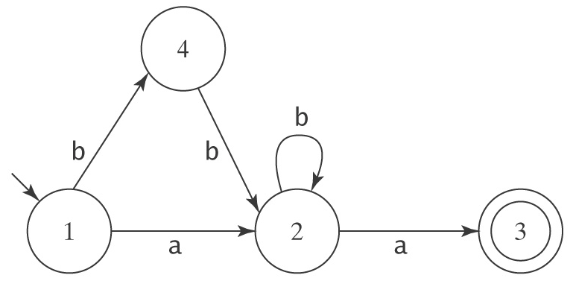
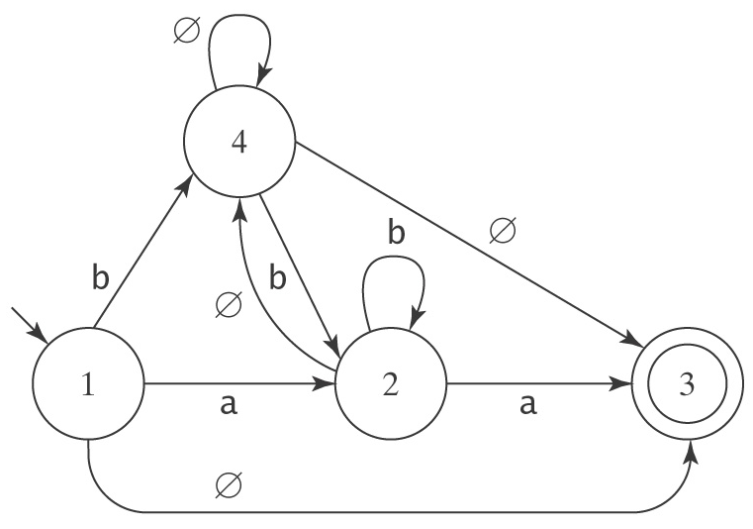
Further Modifications to M Before We Start
2. If any of the required transitions are missing, add them:
becomes:

Slide 33
Ripping Out States
3. Choose a state. Rip it out. Restore functionality.
Suppose we rip state 2.

Slide 34
What Happens When We Rip?
Consider any pair of states p and q. Once we remove rip, how can M get from p to q?
● It can still take the transition that went directly from p
to q, or
● It can take the transition from p to rip. Then, it can take the
transition from rip back to itself zero or more times. Then it can
take the transition from rip to q.

Slide 35
Defining R(p, q)
After removing rip, the new regular expression that should label the transition from p to q is:
R(p, q) /* Go directly from p to q
∪ /* or
R(p, rip) /* Go from p to rip, then
R(rip, rip)* /* Go from rip back to itself
any number of times, then
R(rip, q) /* Go from rip to q
Without the comments, we have:
R′ = R(p, q) ∪ R(p, rip) R(rip, rip)* R(rip, q)

Slide 36
Returning to Our Example
R′ = R(p, q) ∪ R(p, rip) R(rip, rip)* R(p, rip)
Let rip be state 2. Then:
R′ (1, 3) = R(1, 3) ∪ R(1, rip)R(rip, rip)*R(rip, 3)
= R(1, 3) ∪ R(1, 2)R(2, 2)*R(2, 3)
= ∅ ∪ a b* a
= ab*a

Slide 37
The Algorithm fsmtoregex
fsmtoregex(M: FSM) =
1. M′ = standardize(M: FSM).
2. Return buildregex(M′).
standardize(M: FSM) =
1. Remove unreachable states from M.
2. If necessary, create a new start state.
3. If necessary, create a new accepting state.
4. If there is more than one transition between states p
and q, collapse them.
5. If any transitions are missing, create them with label
∅.

Slide 38
The Algorithm fsmtoregex
buildregex(M: FSM) =
1. If M has no accepting states then return ∅.
2. If M has only one state, then return ε.
3. Until only the start and accepting states remain do:
  3.1 Select some state rip of M.
  3.2 For every transition from p to q, if both p
  and q are not rip then do
    Compute the new label R′ for the transition
    from p to q:
    R′ (p, q) = R(p, q) ∪ R(p, rip) R(rip, rip)* R(rip, q)
  3.3 Remove rip and all transitions into and out of it.
4. Return the regular expression that labels the
transition from the start state to the accepting state.

Slide 39
Regular Expressions in Perl
Syntax | Name | Description
abc | Concatenation | Matches a, then b, then c, where a, b, and c are any regexs
a | b | c | Union (Or) | Matches a or b or c, where a, b, and c are any regexs
a* | Kleene star | Matches 0 or more a’s, where a is any regex
a+ | At least one | Matches 1 or more a’s, where a is any regex
a? |  | Matches 0 or 1 a’s, where a is any regex
a{n, m} | Replication | Matches at least n but no more than m a’s, where a is any regex
a*? | Parsimonious | Turns off greedy matching so the shortest match is selected
a+? | ″ | ″
. | Wild card | Matches any character except newline
^ | Left anchor | Anchors the match to the beginning of a line or string
$ | Right anchor | Anchors the match to the end of a line or string
[a-z] |  | Assuming a collating sequence, matches any single character in range
[^a-z] |  | Assuming a collating sequence, matches any single character not in range
\d | Digit | Matches any single digit, i.e., string in [0-9]
\D | Nondigit | Matches any single nondigit character, i.e., [^0-9]
\w | Alphanumeric | Matches any single “word” character, i.e., [a-zA-Z0-9]
\W | Nonalphanumeric | Matches any character in [^a-zA-Z0-9]
\s | White space | Matches any character in [space, tab, newline, etc.]

Slide 40
Regular Expressions in Perl
Syntax | Name | Description
\S | Nonwhite space | Matches any character not matched by \s
\n | Newline | Matches newline
\r | Return | Matches return
\t | Tab | Matches tab
\f | Formfeed | Matches formfeed
\b | Backspace | Matches backspace inside []
\b | Word boundary | Matches a word boundary outside []
\B | Nonword boundary | Matches a non-word boundary
\0 | Null | Matches a null character
\nnn | Octal | Matches an ASCII character with octal value nnn
\xnn | Hexadecimal | Matches an ASCII character with hexadecimal value nn
\cX | Control | Matches an ASCII control character
\char | Quote | Matches char; used to quote symbols such as . and \
(a) | Store | Matches a, where a is any regex, and stores the matched string in the next variable
\1 | Variable | Matches whatever the first parenthesized expression matched
\2 |  | Matches whatever the second parenthesized expression matched
… |  | For all remaining variables

Slide 41
Using Regular Expressions
in the Real World
Matching numbers:
-? ([0-9]+(\.[0-9]*)? | \.[0-9]+)
Matching ip addresses:
([0-9]{1,3} (\ . [0-9] {1,3}){3})
Finding doubled words:
([A-Za-z]+) \s+ \1
From Friedl, J., Mastering Regular Expressions, O’Reilly,1997.

Slide 42
Simplifying Regular Expressions
Regex’s describe sets:
● Union is commutative: α ∪ β = β ∪ α.
● Union is associative: (α ∪ β) ∪ γ = α ∪ (β ∪ γ).
● ∅ is the identity for union: α ∪ ∅ = ∅ ∪ α = α.
● Union is idempotent: α ∪ α = α.
Concatenation:
● Concatenation is associative: (αβ)γ = α(βγ).
● ε is the identity for concatenation: α ε = ε α = α.
● ∅ is a zero for concatenation: α ∅ = ∅ α = ∅.
Concatenation distributes over union:
● (α ∪ β) γ = (α γ) ∪ (β γ).
● γ (α ∪ β) = (γ α) ∪ (γ β).
Kleene star:
● ∅* = ε.
● ε* = ε.
●(α*)* = α*.
● α*α* = α*.
●(α ∪ β)* = (α*β*)*.

Slide 43
Pattern Matching
Given a pattern p and a text T, does p occur as a substring of T?
Solution: Construct a DFSM M for L(Σ*p Σ*); p occurs in T iff M accepts T.
Example: p = abcabb
Below is the minimal DFSM that accepts L(Σ* abcabb Σ*)
b,c
a,b,c
a
a
a
a
q₀
a
q₁
b
q₂
c
q₃
a
q₄
b
q₅
b
q₆
c
b
c
c
b,c

Slide 44
Pattern Searching
Given a pattern p and a text T, find all occurrences of p as a substring of T.
Solution: Construct a DFSM M for L(Σ*p) and run M on T; an accepting state marks the end of an occurrence of p.
Example: p = abcabb
Below is the minimal DFSM that accepts L(Σ* abcabb)
b,c
a
a
a
a
a
q₀
a
q₁
b
q₂
c
q₃
a
q₄
b
q₅
b
q₆
c
b
c
c
b,c
b,c

Slide 45
Multiple Patterns
Multi-Pattern matching
Given several patterns p₁, p₂, …, p_{k}, and a text T, does any of the patterns occur as a substring of T?
Solution: DFSM for L(Σ*(p₁ + p₂ + … + p_{k}) Σ*).
Multi-Pattern searching
Given several patterns p₁, p₂, …, p_{k}, and a text T, find all occurrences of all patterns as substrings of T.
Solution: DFSM for L(Σ*(p₁ + p₂ + … + p_{k})).

